Slide 1
Fission Products
NE 591

Slide 2
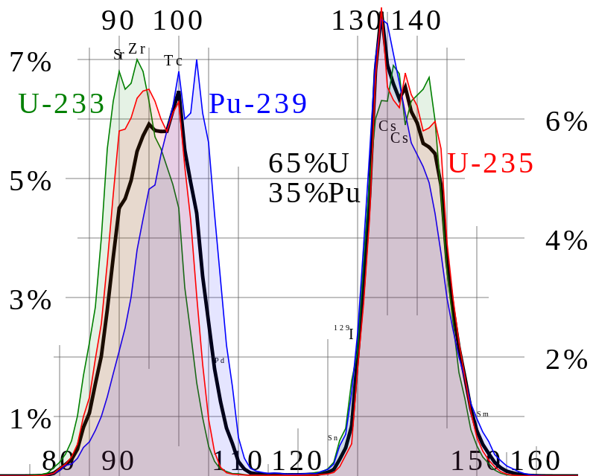
Fission Product Generation
Fission releases around 200 MeV
The fission fragments have 169 MeV of kinetic energy
2 to 3 neutrons with an average energy of 2 MeV
7 MeV of prompt gamma ray photons
The remaining energy is released by beta decay
Every fission product that is produced is now in the crystal lattice of the fuel, changing the microstructure

Slide 3
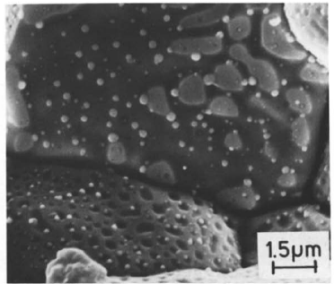
There are various types of fission products that form in the fuel
Soluble oxides (Y, La and the rare earths)
Dissolved in the cation sublattice
Insoluble oxides (Zr, Ba and Sr)
Form insoluble oxides in the fluorite lattice
Metals (Mo, Ru, Pd, and Tc)
Form metallic precipitates
Volatiles (Br, Rb, Te, I and Cs)
Exist as gases at high temperatures of the pellet interior
Also exist as solids at the cooler pellet exterior
Noble gases (Xe, Kr)
Essentially insoluble in the fuel matrix
Form either intragranular (within grain) voids or bubbles or intergranular (grain boundary) bubbles

Slide 4
All of the fission products impact the behavior of the fuel

Slide 5

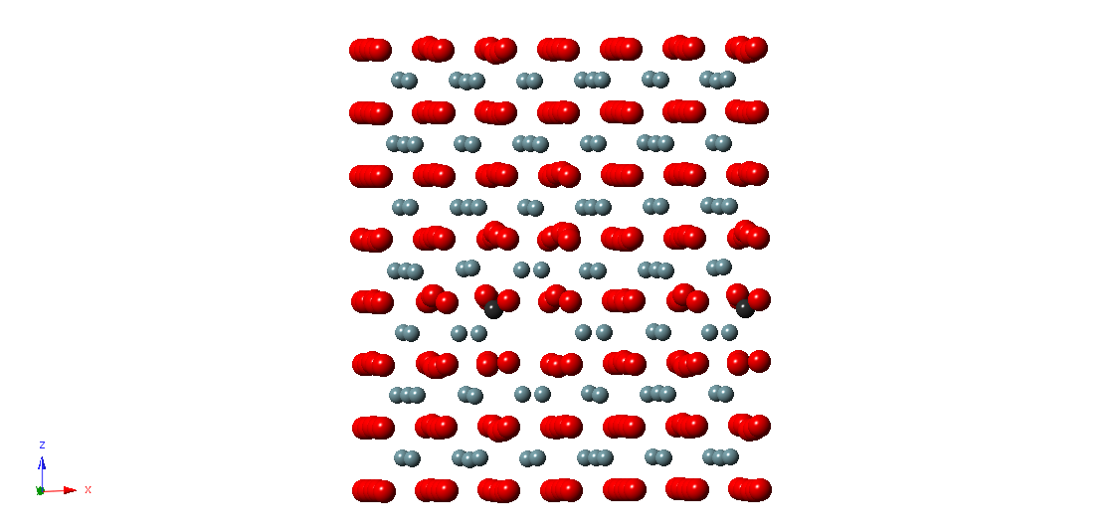
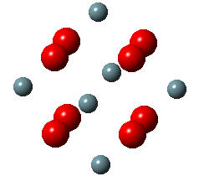
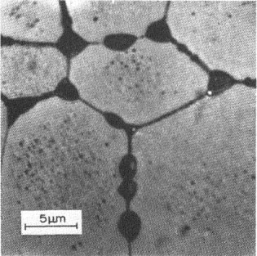
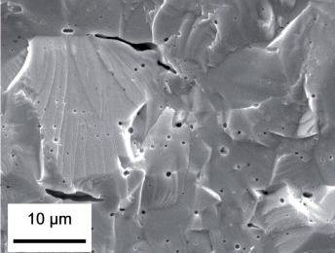
Fission Gas Release
Fission gases (Xe, Kr) are released in a process composed of three stages in UO2
Stage 1: Gas atoms are produced throughout the fuel due to fission and diffuse towards grain boundaries
Small intragranular bubbles form within the grains, but never get larger than a few nm radius due to resolution from energized particles
Gas atoms that don’t get trapped within the intragranular bubbles migrate to grain boundaries
Atoms forming a vacancy cluster

Slide 6
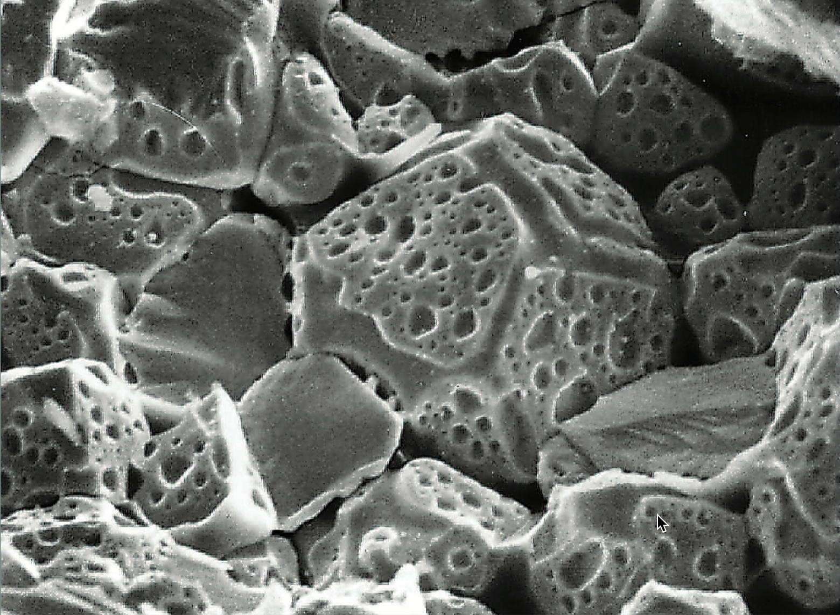
Fission Gas Release
Stage 2: Gas bubbles nucleate on grain boundaries, growing and interconnecting
Stage 3: Gas travels through interconnected bubbles to a free surface

Slide 7
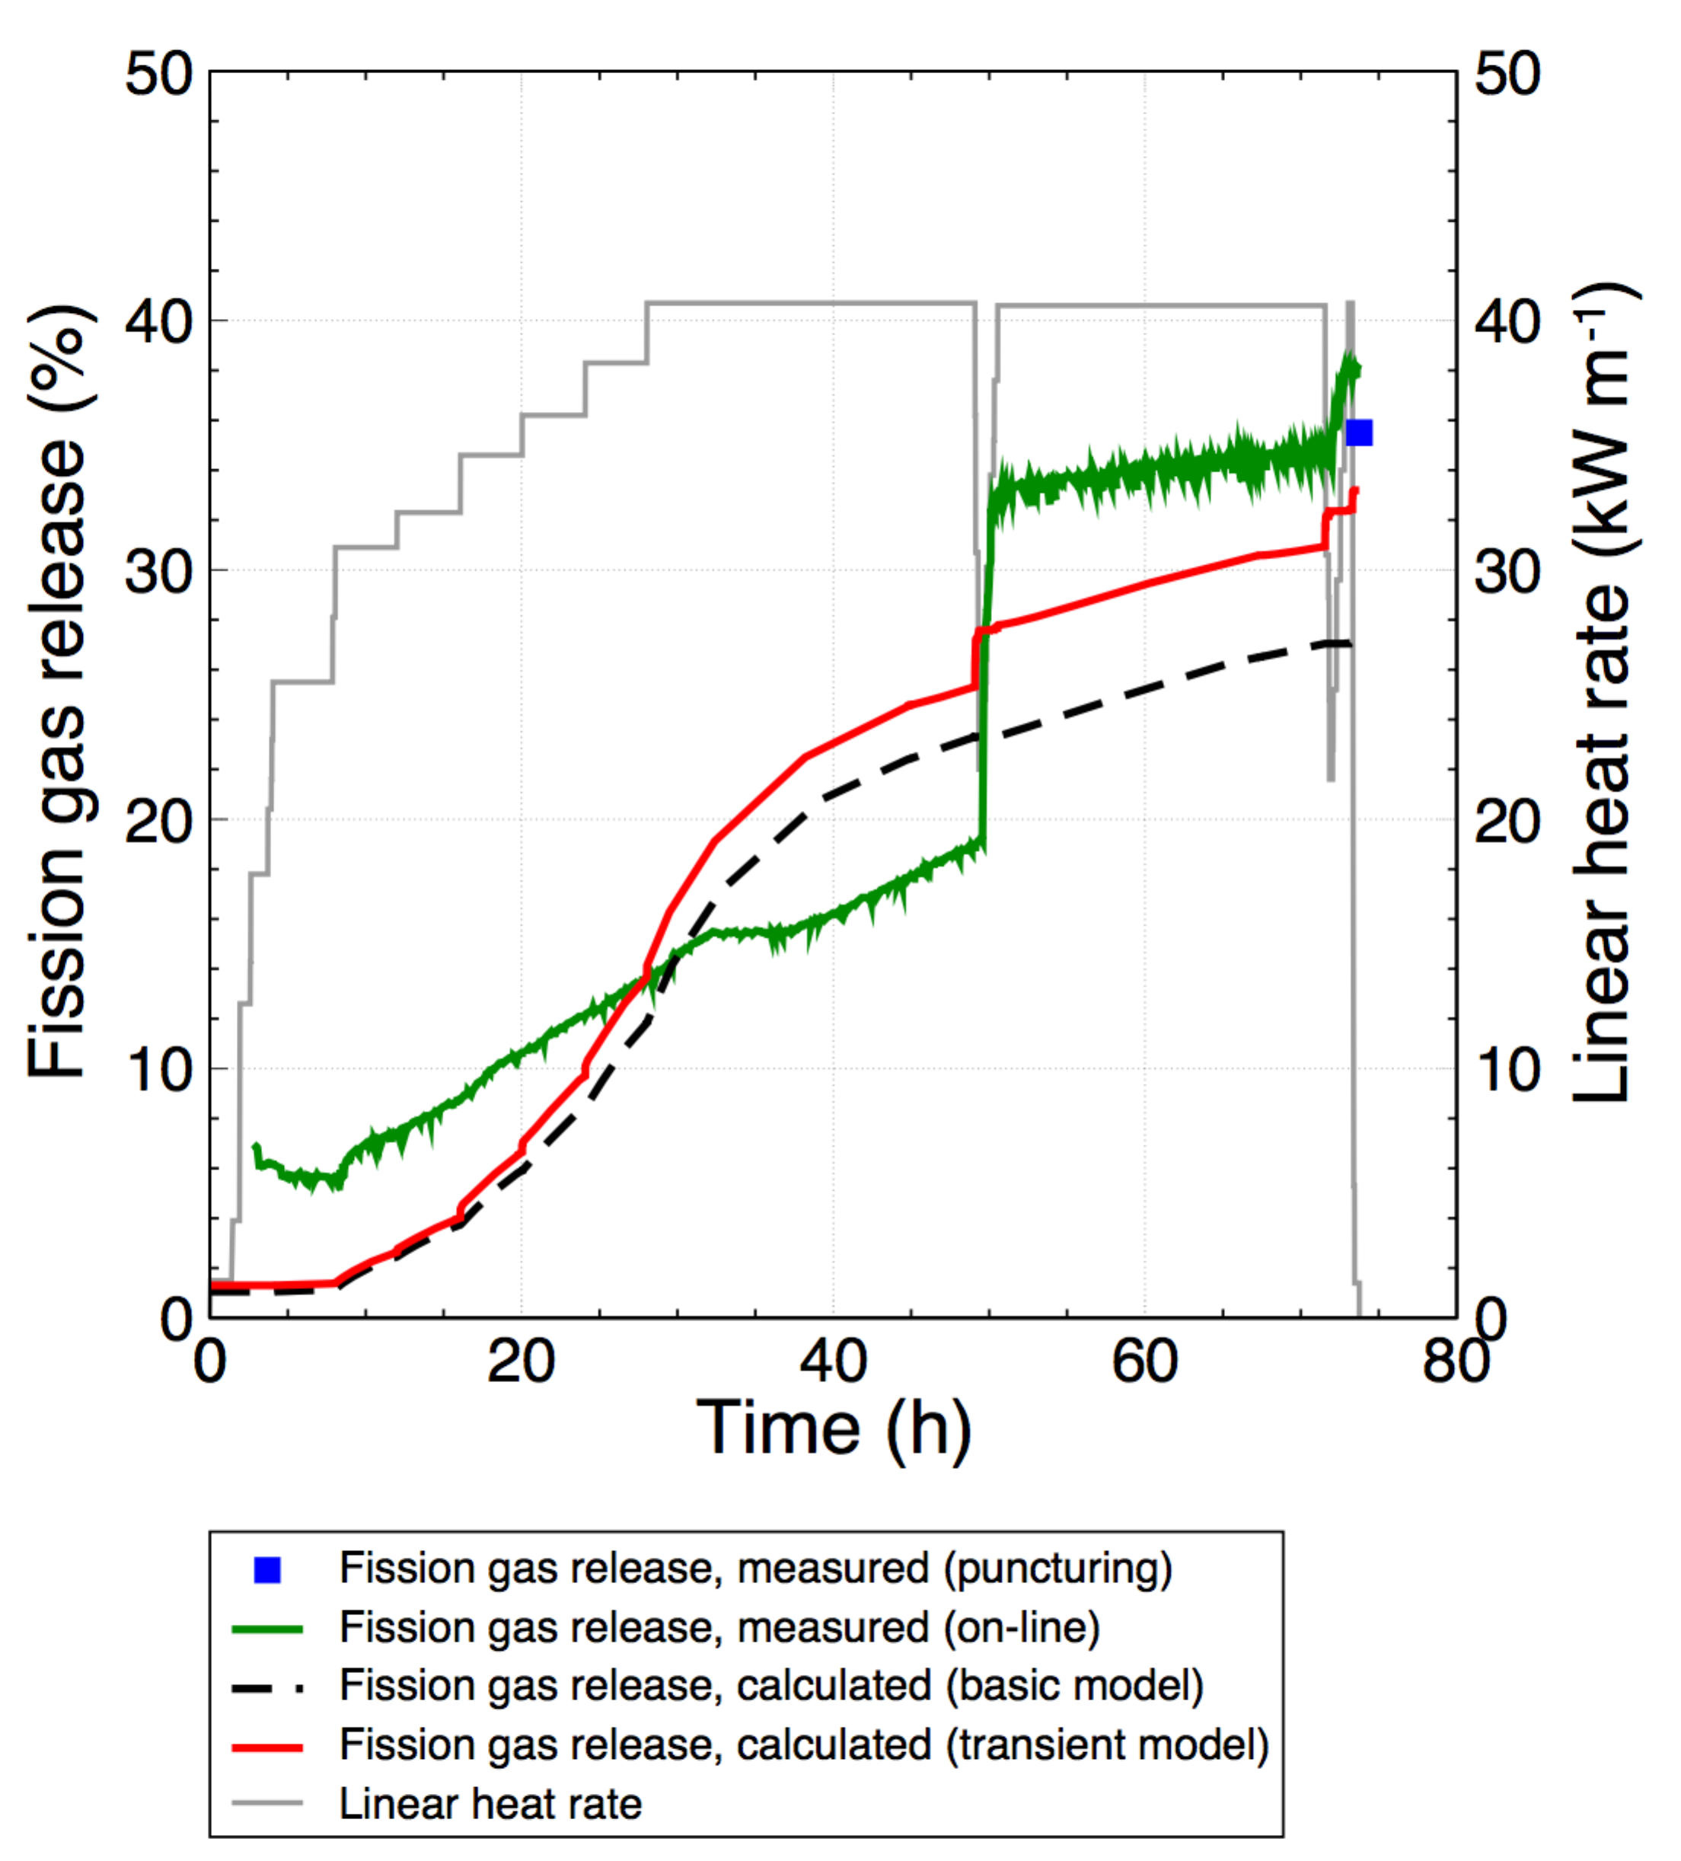
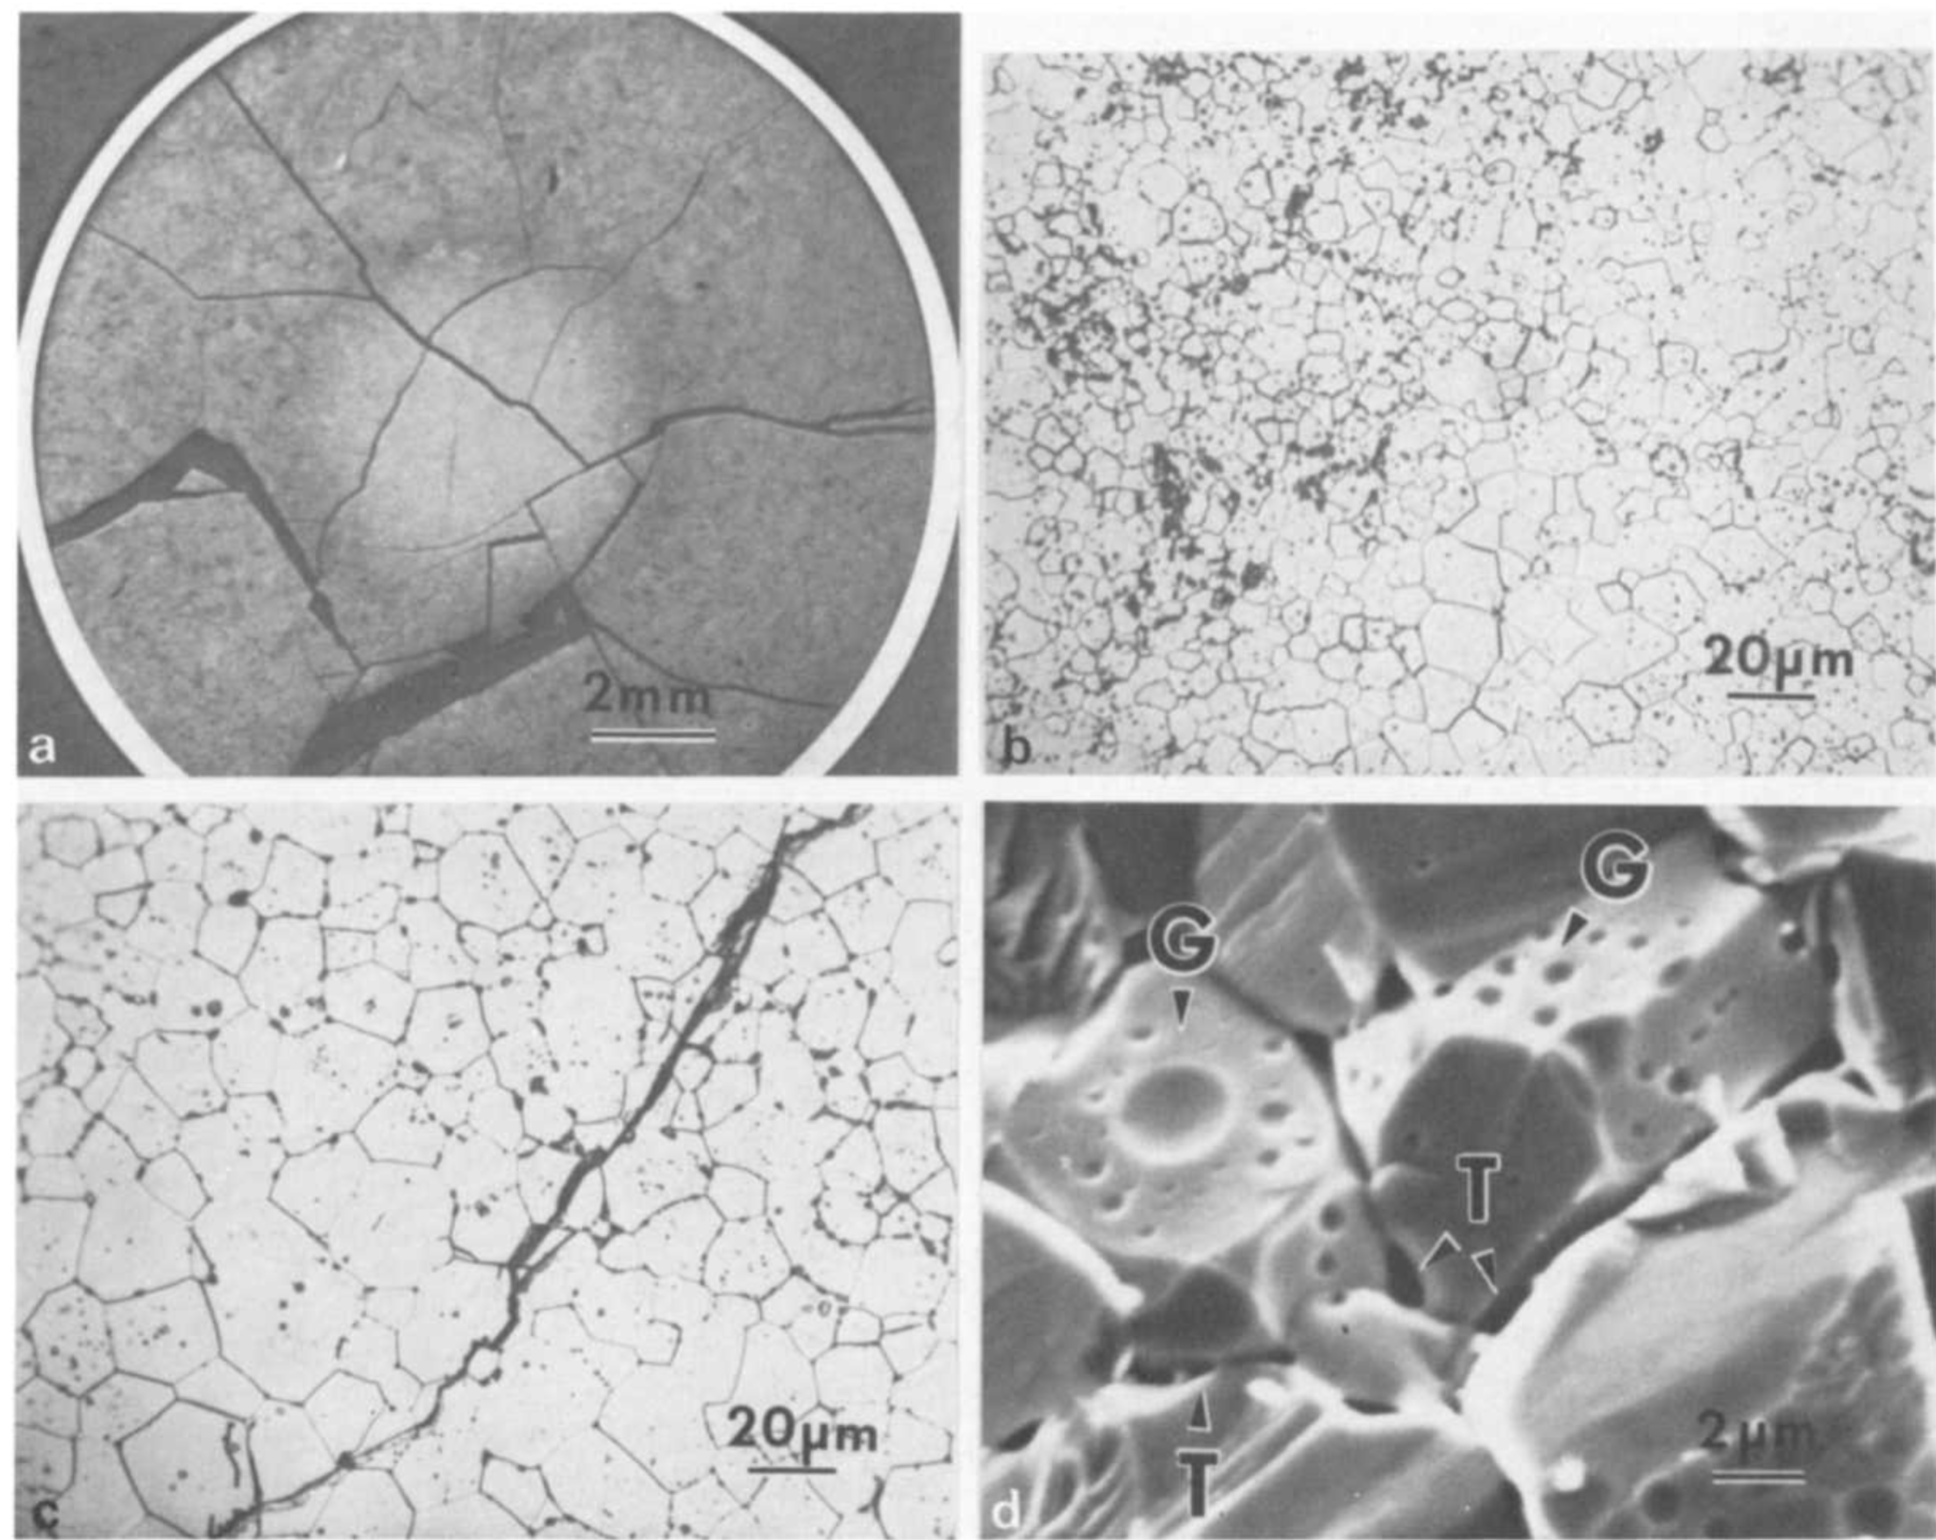
Fission Gas Release
Fission gas release also occurs due to mechanisms that don’t depend on diffusion
Release can occur to particle recoil and knockout at low temperature
It can occur due to fracture during rapid transients

Slide 8
Fission Gas Release
Released fission gas enters the gap and plenum, causing various problems
Xe and Kr have very low thermal conductivities, reducing the gap conductance
The plenum pressure increases
The volatile fission gases corrode the cladding
They are also radioactive and hazardous, causing problems when the cladding is breached
Fission gas release experiments:
Post irradiation annealing
Fuel is irradiated at low temperature
Fuel is then placed into a furnace and heated
Gas atom release is then measured
In-pile release
Gas release is measured during reactor operation
It is much more difficult than post-irradiation annealing
Total amount released is measured by puncturing cladding after irradiation
Release with time can be estimated using a pressure transducer inside an instrumented fuel rod

Slide 9
Fission Gas Release
Fission gas release models attempt to predict the rate at which gas is released from the fuel
To model fission gas release, ideally we must model all three stages of gas release
Diffusion of gas atoms to grain boundaries
Growth and interconnection of grain boundary bubbles
Transport of gas atoms through interconnected bubbles to free surfaces
The earliest models only considered Stage 1
Most models now consider stage 1 and 2
There are no models that consider all three stages

Slide 11
Summary
Fission products change the fuel behavior
Fission gas is released in three stages
Fission gas production and diffusion to grain boundaries
Grain boundary bubble nucleation, growth, and interconnection
Gas transport through interconnected bubbles to free surfaces
Fission gas release is measured using post-irradiation annealing and in pile experiments

